Slide 1
Progressivism is a philosophy based on the Idea of Progress, which asserts that advancements in science, technology, economic development, and social organization are vital to the improvement of the human condition.

Slide 2
Goals of Progressives
Improve social conditions
Social Welfare
Economic reform for the lower class
Create efficiency (government and economics)
“Strengthen the State”

Slide 3
Origins of Progressivism
Copied ideas from Populists
Society now too complex to allow for laissez faire governing
Incredible growth of big business made business more powerful than government
Increased voice from women
Progressives crossed party lines

Slide 4
Political Reforms
Recall
Referendum
Initiative
Secret Ballot
16th
17th Amendment- Direct Election of Senators
18th
19th Amendment- Women’s Suffrage

Slide 5
Muckrakers and Progressives
The term derives from the word muckrake used by President Theodore Roosevelt in a speech in 1906, in which he agreed with many of the charges of the muckrakers but asserted that some of their methods were sensational and irresponsible. He compared them to a character from Bunyan's Pilgrim's Progress who could look no way but downward with a muckrake in his hands and was interested only in raking the filth.
1. Based on the paragraph, what do you think a muckraker is?
2. Do you think the term muckraker has a positive or negative connotation and why?

Slide 6
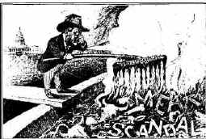

Slide 7
SIMILARITIES OF MUCKRAKERS AND PROGRESSIVES
wanted to help the URBAN LOWER CLASS
wanted to end POLITICAL CORRUPTION
Leaders usually were from the upper and middle class educated members in society
influenced the public and politicians to promote change in society

Slide 8
DIFFERENCES BETWEEN MUCKRAKERS AND PROGRESSIVES
MUCKRAKERS WERE
OUTSIDE OF THE POWER STRUCTURE
WRITERS, PHOTOGRAPHERS, EDITORS, ETC.
SOMETIMES THROWN INTO THE SITUATION THEY COVERED TO EXPOSE THE CORRUPTION OR SOCIAL ILL
PROGRESSIVES WERE
REMOVED FROM THE SPECIFIC SOCIAL ILL
MUCH MORE POLITICALLY POWERFUL, OR POLITICIANS THEMSELVES

Slide 9
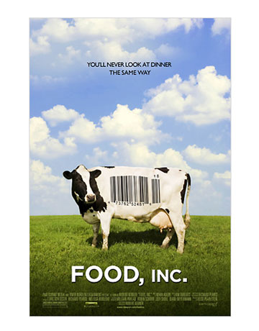
Modern Day Muckrakers
Who today would be considered a muckraker?
“Supersize Me”
“Food Inc.’
60 Minutes
Michael Moore
D’nesh Disouza
Ralph Nader
What methods can be used in the modern world to expose the problems of the country?
TV/Radio/Internet/Movies
Books/Magazines

Slide 10
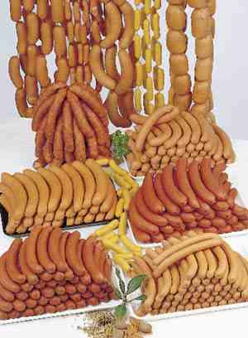
UPTON SINCLAIR- THE JUNGLE
"I aimed at the public’s heart and by accident hit its stomach."
Goal was to show the poor conditions and plight of the immigrant workers

Slide 11
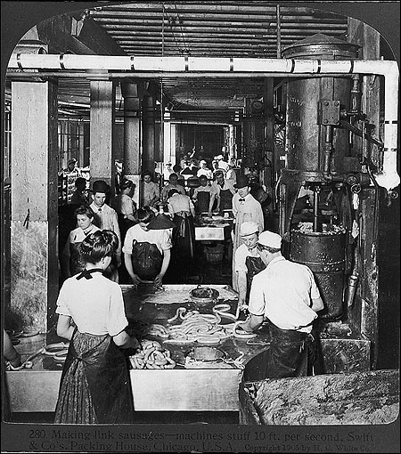

Slide 12
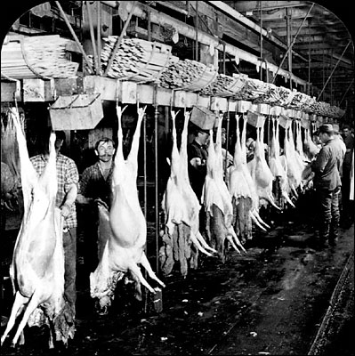

Slide 13
AFFECT OF THE Jungle
Meat Inspection Act (1906) Required meat to be inspected for freshness and graded for quality.
1906- Pure Food and Drug Act-products labeled, sold correctly, ingredients listed
Eventually led to the Food and Drug Administration (FDA) 1930

Slide 14
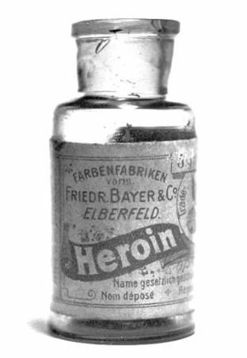
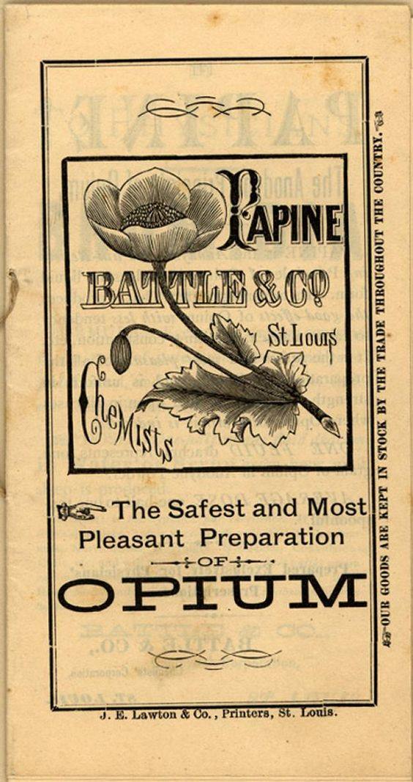
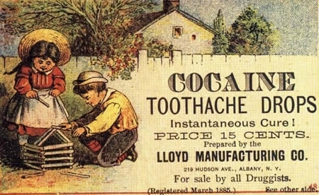

Slide 15
Jacob Riis
Jacob Riis (1849-1914) - How the Other Half Lives, about the slums
As you look at the pictures:
1. What are the rough conditions for the poor?
2. How does the photograph attempt to bring out emotion in the viewer?

Slide 16
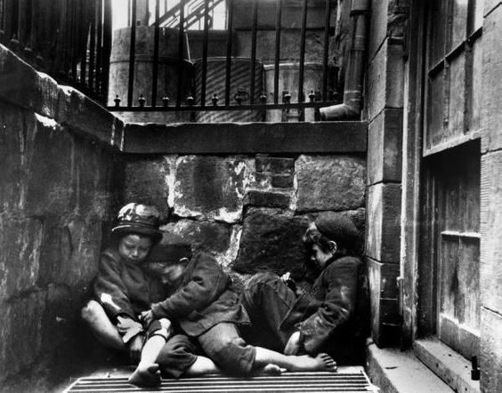

Slide 17
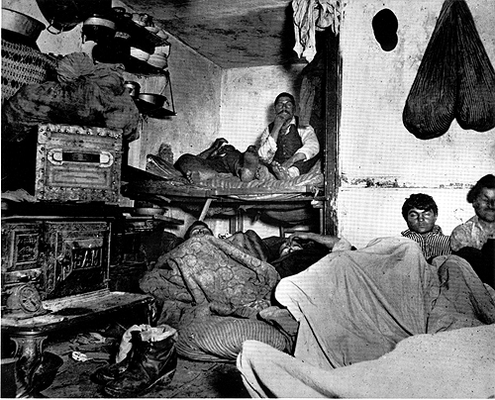

Slide 18
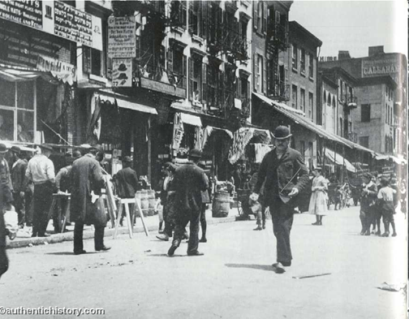
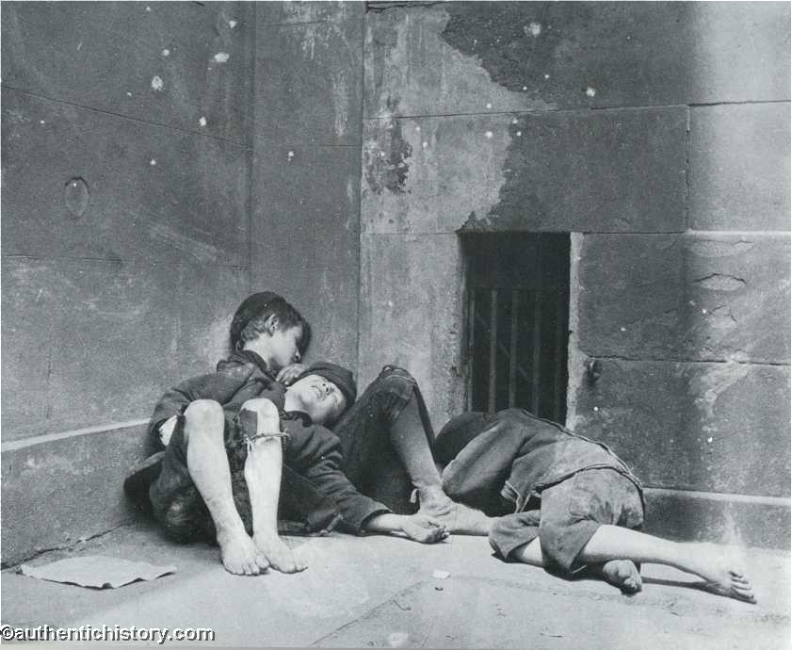
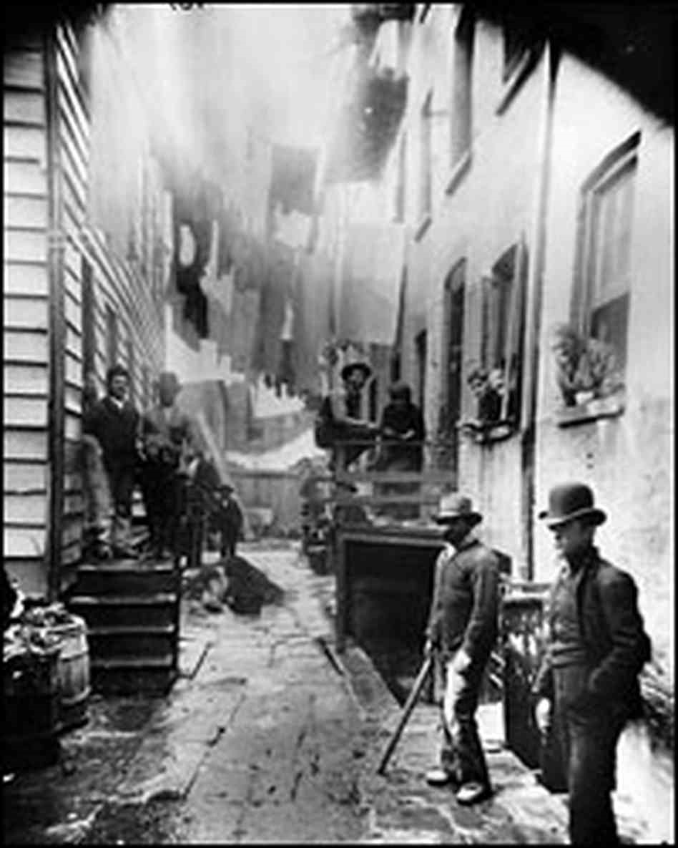

Slide 19
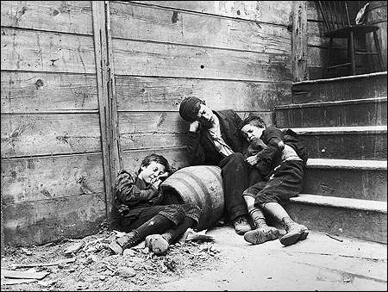

Slide 20
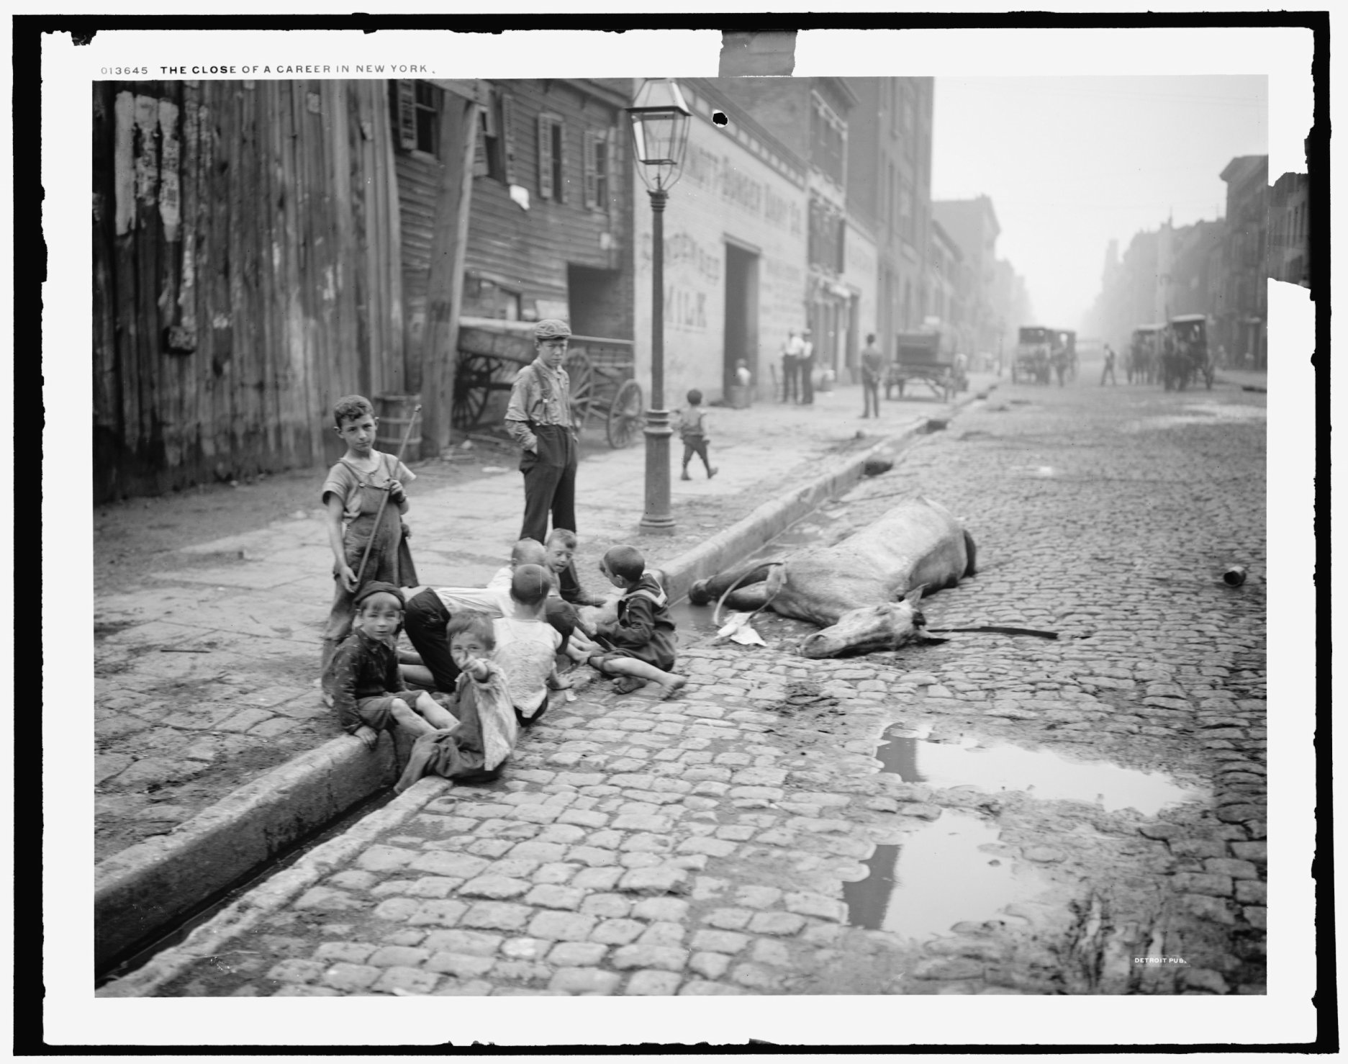

Slide 21
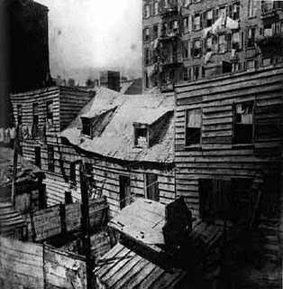
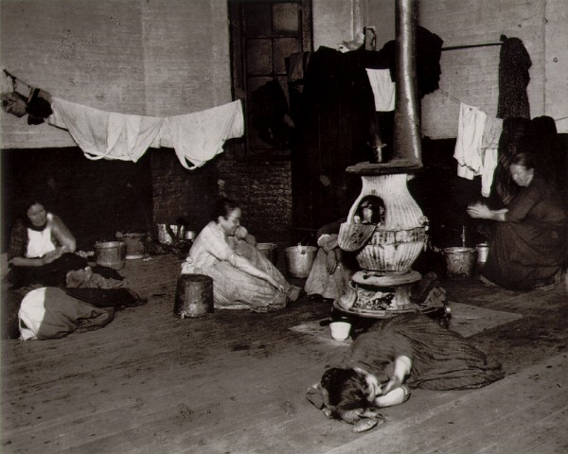

Slide 22
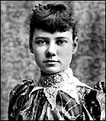
Nellie Bly(Elizabeth Cochran)
Offended by an article in Pittsburgh paper titled “What Girls Are Good For”
Criticized Mexican govt and thrown out of country
Moved to NY, couldn’t get a job for 6 months… editor at NY Sun said she could have a job if she pretended to be insane

Slide 23
Nellie Bly
Committed to the Blackwell's Island Insane Asylum, Bly experienced its conditions firsthand. The food—gruel broth, spoiled meat, bread that was little more than dried dough—she found inedible. The inmates were made to sit for much of each day on hard benches with scant protection from the cold. The nurses were rude and abusive, telling the patients to shut up and beating them if they did not. Speaking with her fellow residents, Bly was convinced that some were as sane as she was.
Ten Days in a Mad-House

Slide 24
Jane Addams- Hull House
Settlement house for immigrants and women
3 R’s- residence, research, reform
By 1920, 500 houses in U.S.
Lasted until 2012!!

Slide 25
Upton Sinclair (1878–1968) — The Jungle (1906), U.S. meat-packing industry, and the books in the "Dead Hand series that critique the institutions (journalism, education, etc.) that could but do not prevent these abuses.
▪ Jacob Riis (1849-1914) – “How the Other Half Lives”, about the slums
▪ Ray Stannard Baker (1870–1946) — Race issues
Frances Keillor (1873-1952) — Studied chronic unemployment in her book "Out of Work”
Frank Norris (1870 -1902) “The Octopus”
▪ Lincoln Steffens (1866 – 1936) “The Shame of the Cities” (1904)
▪ Ida M. Tarbell (1857 – 1944) exposé, “The History of the Standard Oil Company”
Henry Dearest Lloyd (1852-1920) - Wealth Against Commonwealth, exposed the corruption within the Standard Oil Company
Thomas W. Lawson (1857-1924) “Frenzied Finance”(1906) on Amalgamated Copper stock scandal
Nellie Bly (1864 – 1922) “Ten Days in a Mad-House”
Helen Hunt Jackson (1831–1885) — “A Century of Dishonor”, U.S. policy regarding American Indians
Modern Muckrakers
Ralph Nader — consumer rights advocate; Unsafe at Any Speed (1965), exposed unsafe automobile manufacturing
Morgan Spurlock — American Filmmaker; exposed through example the dangers of McDonalds in his documentary Super Size Me
Al Gore - An Inconvenient Truth (2006)
Michael Moore — documentary filmmaker, director of Roger and Me, Bowling for Columbine, Fahrenheit 911, and SiCKO

Slide 26
Suffragettes
Early movement
Seneca Falls convention (1848)
Elizabeth Cady Stanton/Lucretia Mott
National American Women Suffrage Movement
Susan B. Anthony/ arrested for voting in 1872!!
WCTU –Frances Willard
National Women’s Party(1917)
Alice Paul/Lucy Burns/Carrie Catt
Imprisoned for “obstructing traffic” while picketing Pres. Wilson
Men would abuse them while they protested/men who helped them were arrested
Went on hunger strike in prison and guards forced raw eggs down her throat thru a feeding tube
“Night of Terror” (Nov. 15th 1917)- women protestors beaten unconscious by guards

Slide 27
Suffraggettes
National Women’s Party(1917)
Alice Paul/Lucy Burns/Carrie Catt
Imprisoned for “obstructing traffic” while picketing Pres. Wilson
Men would abuse them while they protested/men who helped them were arrested
Went on hunger strike in prison and guards forced raw eggs down her throat thru a feeding tube
“Night of Terror” (Nov. 15th 1917)- women protestors beaten unconscious by guards

Slide 28
19th Amendment
Impact of WWI on women’s suffrage huge!!!
Wilson “urges” Congress to pass it as a “war measure”!! ???
Men went to war, women went to work!!!
“No taxation without representation”!!!!!!
1920- 19th Amendment
Prevents a state from banning the right of women to vote!!! What does that imply?
Some states had allowed women the right to vote much earlier than the amendment
New Jersey originally (1776), but later banned specifically
Wyoming 1869, western states usually allowed women to vote earlier

Slide 29
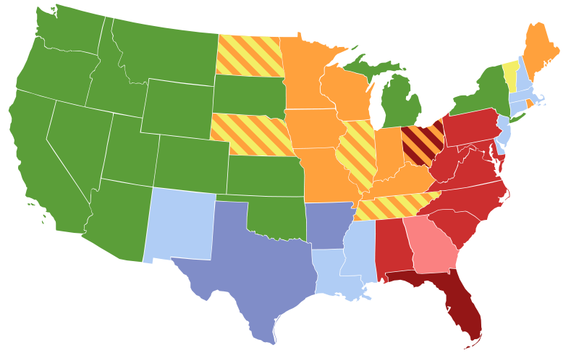
Full suffrage-green
Presidential suffrage-orange
Primary suffrage- dark blue
Municipal suffrage-yellow
School, bond, or tax suffrage-light blue
Municipal suffrage in some cities- dark red
Primary suffrage in some cities- pink
No suffrage-red

Slide 30
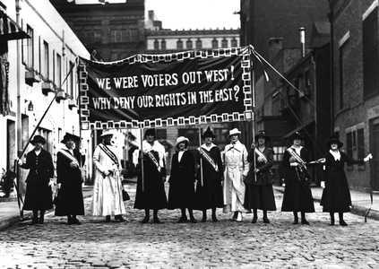

Slide 31
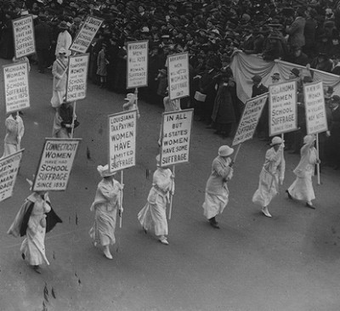

Slide 32
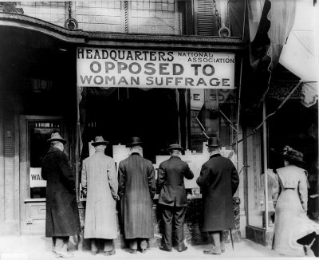

Slide 33
Economic Reforms
16th Amendment-1913
Income Tax- why is this progressive?
Aimed at the rich
Overrules Pollock vs. Farmers Loan and Trust Co. (1895)
What conclusions can you draw from the need to have an income tax?
Government getting bigger
US running out of land to sell to make $$
Elkins Act (1903) (RR rebates banned)Hepburn Act (1906)(max RR rates_- these laws gave teeth to and Interstate Commerce Act (1887)
18th Amendment-
saved $$$
WWI impact?
We needed wheat/barley for bread for the troops

Slide 34
Moral Reforms
18th Amendment- banned sale, distribution of alcohol
Social ills
Spousal abuse
Muller vs. Oregon (1908)
Protected women’s rights in the workplace(10hr. Workday)…. What was their rational that specifically gave women more protection than Lochner case??
Differences between the sexes!!
Women are weaker, they need to make babies
Making babies is in the “public interest and care”, so women must be protected!!
“Brandeis Briefs”- forerunner of civil rights legislation!!!!!
Only place in our government that basically says there is an inequality between the sexes!!!

Slide 35
Government Regulation of Big Business
Interstate Commerce Act (1887)
To regulate the RR’s
ICC
Sherman Anti Trust Act (1890)
Actually bans monopolies and cartels, not trusts!!
Written by Rockefeller’s friend!!! Hence the trust invention!
Never really used until TR
Clayton Anti Trust Act (1914)
Gave teeth to Sherman Act

Slide 36
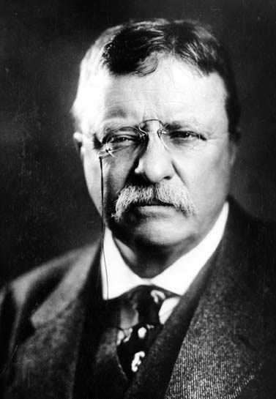
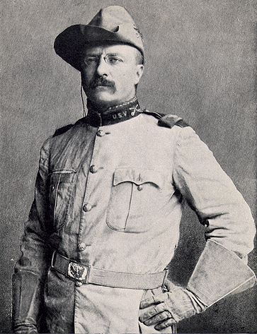

Slide 37
Teddy the Trustbuster
1st President to actively campaign against big business and the trusts….. Is this a good political move?
Alienates big business, but popular support from the people
TR believes that the role of the President should be to act on behalf of the people… Agree??
How is this vastly different from all previous presidents???
1st activist President…
Previously, do what Constitution allows,, be more of a manager/CEO, than a hands on leader in domestic issues
(think GW!)
How does this affect the office of the presidency??
Drastic increase of presidential power

Slide 38
TR QUOTES
Probably the greatest harm done by vast wealth is the harm that we of moderate means do ourselves when we let the vices of envy and hatred enter deep into our own natures.
The most practical kind of politics is the politics of decency.
The most successful politician is he who says what the people are thinking most often in the loudest voice.
When they call the roll in the Senate, the Senators do not know whether to answer "Present" or "Not guilty."
It behooves every man to remember that the work of the critic is of altogether secondary importance, and that, in the end, progress is accomplished by the man who does things.

Slide 39
TR Square Deal
2 part- Trustbusting and Conservationism
We wish to control big business so as to secure among other things good wages for the wage-workers and reasonable prices for the consumers.
All really civilized communities should have effective arbitration treaties among themselves.
Be fair to both the workers and owners
Try to force them to settle disputes on their own, if not, then arbitration, if not, then he will intervene!!!
TR was 1st president to actively use anti trust laws to limit the power of big business
“good trusts” vs. “bad trusts”

Slide 40
TR Conservationism
Early efforts
Desert Land Act (1877)
Upped the Homestead Act to 640 acres
Forest Reserve Act (1891)
Carey Act (1894)
Companies can improve land
TR was 1st politician to actively try to conserve the land
Newlands Act 1902- irrigation (Roosevelt Dam)
Created National Parks system/ US Forest Service
Preserved 230,000,000 million acres
Wildlife and Game Commission
Bird preserves

Slide 41
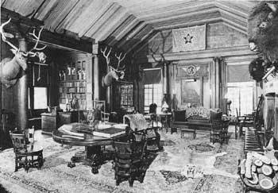

Slide 42
Taft and Wilson
Both Taft and Wilson are considered trustbusting progressive Presidents
Taft actually went after 90 trusts in his 4 years as Pres. TR 44 in 7 ½ years.
More on these guys when we get back to politics

Slide 43
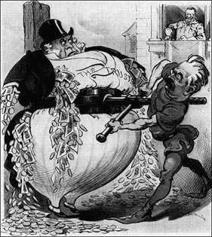

Slide 44
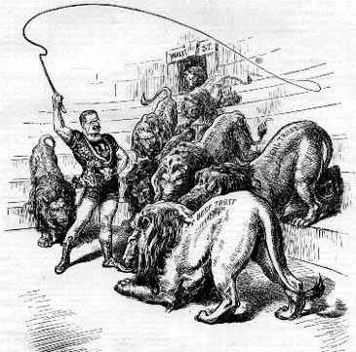

Slide 45
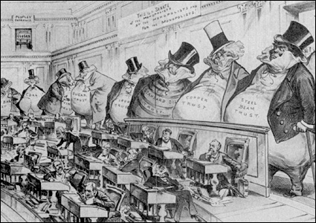

Slide 46
Short Answer Questions
How did the Progressive and Populist Era try to limit the power of the railroads?
Explain how one of the following muckrakers solved the ills of society:
Nellie Bly
Upton Sinclair
Jacob Riis
Ida Tarbell
How was Theodore Roosevelt different from previous Presidents?

