Slide 1
Basic Strategy

Slide 2
Union Armies
Named for the Major River in the area, usually.
Army of the Potomac
Army of the Tennessee
Army of the Ohio
Army of the Cumberland
Army of the Mississippi

Slide 3
Confederate Armies
Named generally for their Area of Operations.
Army of Northern Virginia
Army of Mississippi
Army of Tennessee

Slide 4
Naming Battles Union named for geographic feature (rivers, etc.). Confederates for town nearest fight.
Union | Confederacy
Bull Run (1 and 2) | Manassas (1 and 2)
Ball’s Bluff | Leesburg
Pittsburg Landing | Shiloh
Antietam | Sharpsburg
Stones River | Murfreesboro
Opequon Creek | Winchester

Slide 5
3 Periods of the War
Early War | April 1861/June 1862 | Small 3 Month Regiments
 |  | Small armies and battles
 |  | Low number of casualties
 |  | “smoothbore” muskets
 |  | Napoleonic (Linear) tactics.

Slide 6
“Mid War” | July 1862/April 1864 | Large 3 year Regiments
 |  | Larger armies and battles
 |  | Higher casualties
 |  | Rifled arms w/ minie balls
 |  | Napoleonic (Linear) tactics.

Slide 7
“Late War” | April 1864/April 1865 | Large armies
 |  | Small & combined veteran regiments
 |  | New 3 months regiments
 |  | Total War
 |  | Less Linear
 |  | Trench Warfare

Slide 8
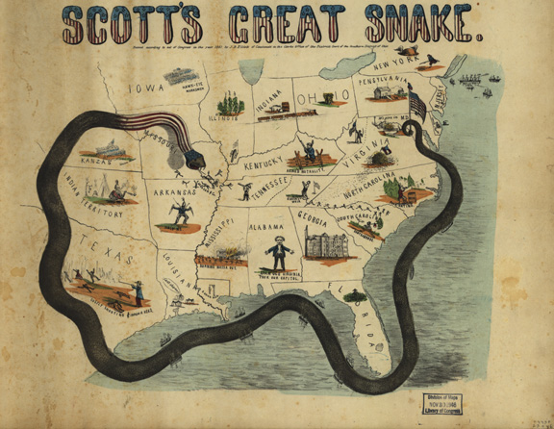

Slide 9
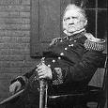
Proposed by General Winfield Scott, commander of the Union Army in 1861
Proposed that 60,000 troops move down the Mississippi River with gunboats until they had secured the river from Cairo, Il. to the Gulf
Securing the Mississippi along with an effective blockade would seal off the Confederacy

Slide 10
Scott believed Union troops should then stop and wait for Southern Union sympathizers to turn on their Confederate governors and compel them to surrender
War fever made many very critical of the passive ground operations proposed by Scott

Slide 11
Adoption of the Anaconda Plan
1. Blockade the coast of the South to prevent the export of cash crops and import of vital materials
2. Cut the South off from the West by controlling the Mississippi River
3. Divide the South by capturing the Tennessee River Valley and marching through Georgia to the Atlantic caostline

Slide 12
4. Capture the Confederate capital of Richmond, Virginia
This would be implemented in varying forms throughout the war by several Union generals. Many, including Lincoln, believed too much focus was placed on Richmond and not the destruction of the Confederate Army

Slide 13
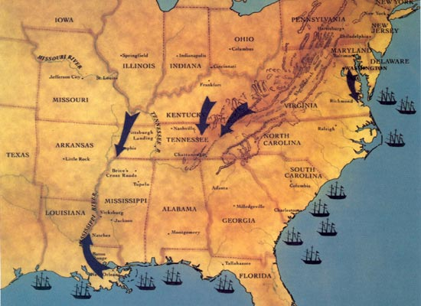

Slide 14
Southern Strategy
Not Lose.
The South simply had to outlast the Union will to fight.
This strategy was the same as the colonists in the American Revolution.
Fought an “Offensive Defense” campaign.
Move aggressively on strategic targets. (Offensive)
Make the enemy attack on ground chosen by CSA. (Defensive)

Slide 15
Distractions – Both Sides.
“Capture the Flag”
Union – Capture Richmond VA, CS Capital.
Manassas (1 and 2), Peninsula Campaign, Overland Campaign, etc.
Confederacy – Capture D.C.
Sharpsburg (MD), Gettysburg (PA), Monocacy (MD)
Maryland is important.
Abe Must maintain MD – Martial Law.

Slide 16
