Slide 1
America Enters the War

Slide 2
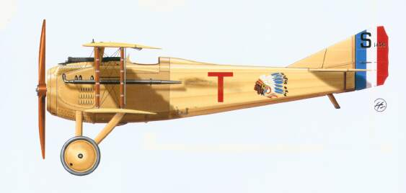
Before America Declares War…
Americans volunteered in Allied armies.
Lafayette Escadrille
American volunteer pilots flying for France.
11 became Aces

Slide 3
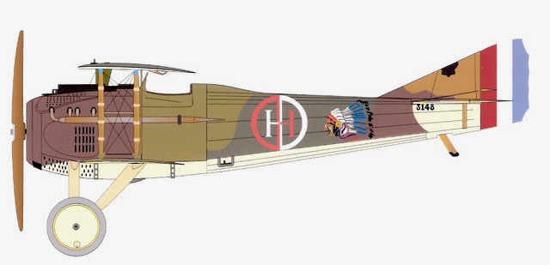
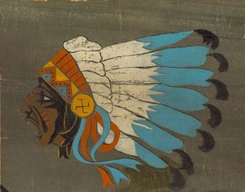
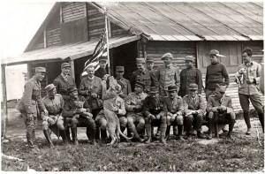
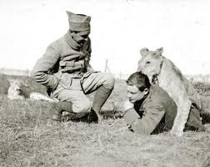

Slide 4
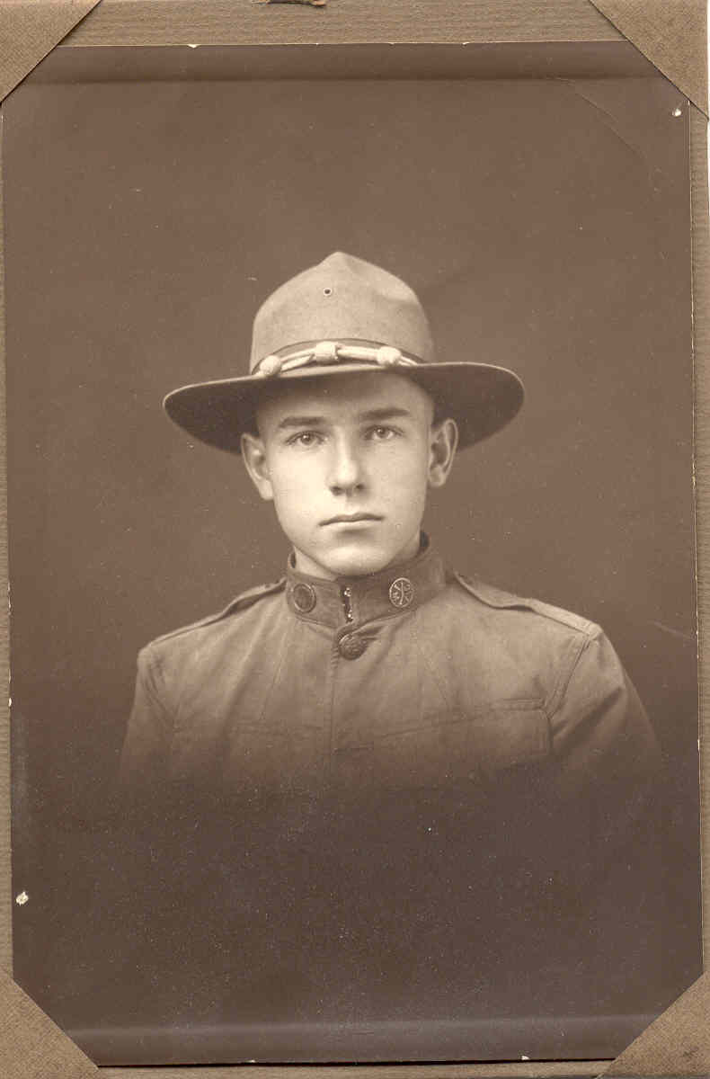
America Declares War
April 2, 1917
Takes time to get ready!
Raise Money (How?)
Raise Army (How?)
2 Million Volunteers
2.8 million draftees
Also known as - Doughboys
American Doughboy from the 32nd “Red Arrow Division” from Michigan.

Slide 5
Selective Service Act 1917
1st National Draft
Draft = Conscription
Conscription is “forced” or involuntary military service.
How it worked:
Adult Males had to register.
If their number was drawn, they had to appear before a “Local Draft board”
Local Draft board determined if they would be enlisted in the military

Slide 6
Selective Service Pro/Con
Pro:
Created a large army quickly
Was seen as “Democratic” because all males were eligible (Rich/Poor, Black/White, Country/City)
Con:
“Forced” military service – (Like in Europe?)
Abandoned American Volunteer Army Tradition
Violated the Bill of Rights (Maybe, maybe not)

Slide 7
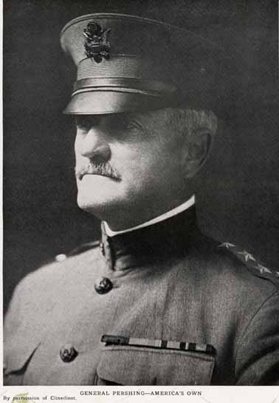
American Expeditionary Force (A.E.F.)
Gen. John J. Pershing
“Black Jack”
American Commander of A.E.F.
Wanted American troops to fight together as an American Force
~ Pride, Nationalism
British and French wanted Americans to be used as replacements in their damaged armies.

Slide 8
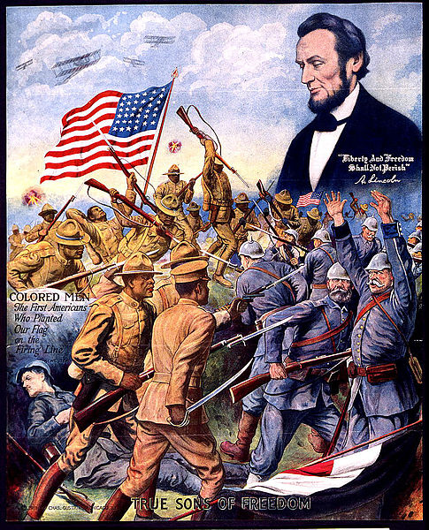
African American Soldiers
African American soldiers served in segregated units of all black soldiers led by white officers.
They were attached to the French Army
Many French colonial troops were from Africa and also black.

Slide 9
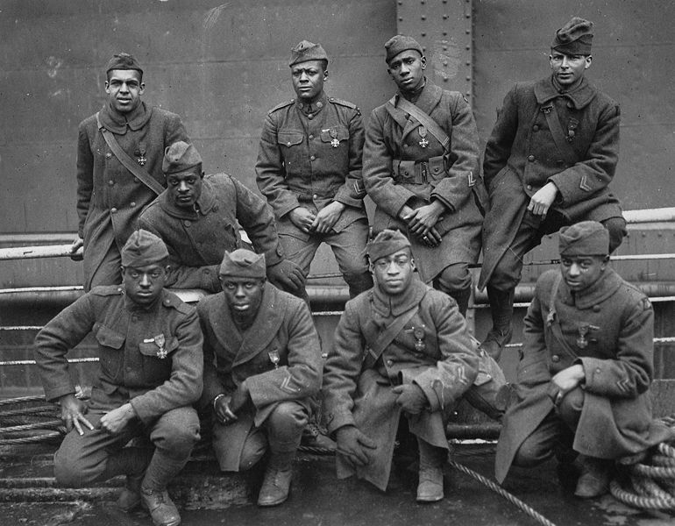
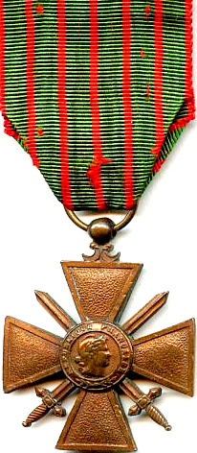
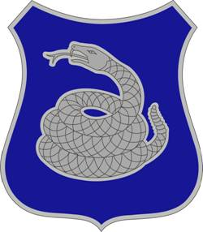
369th Infantry – “harlem hellfighters”
Award the French Croix de Guerre (Cross of War) because of their service with the French army.

Slide 10
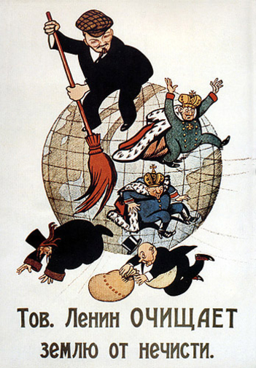
Timeline – When Did Americans Arrive?
Feb 1917 – Russian Revolution begins
Bread Riots in the Streets of St. Petersburg
Tsar still living well, but citizens are starving.
Citizens Blame WWI
November 1917 – Communists take over
Tsar Nicholas II and his family is killed
Vladimir Lenin and Communists rule
Russian Civil War begins… 1918-1921ish

Slide 11
When Russia leaves…
…German troops are free to move from Eastern to Western front.
Reinforce the armies against France and England.
Prepare to launch major attack (1918 offensive)
American Troops (A. E.F.) begin to arrive on Western Front

Slide 12
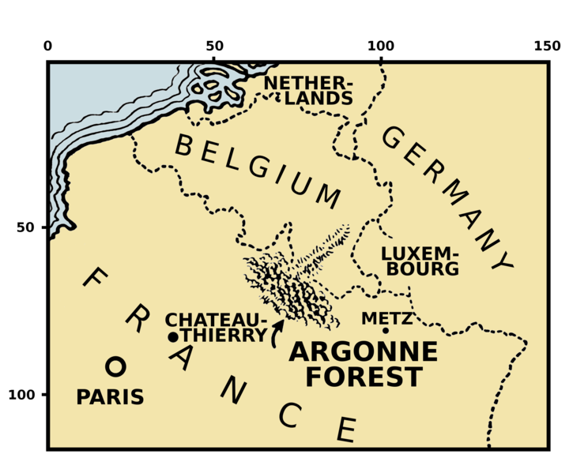

Slide 13
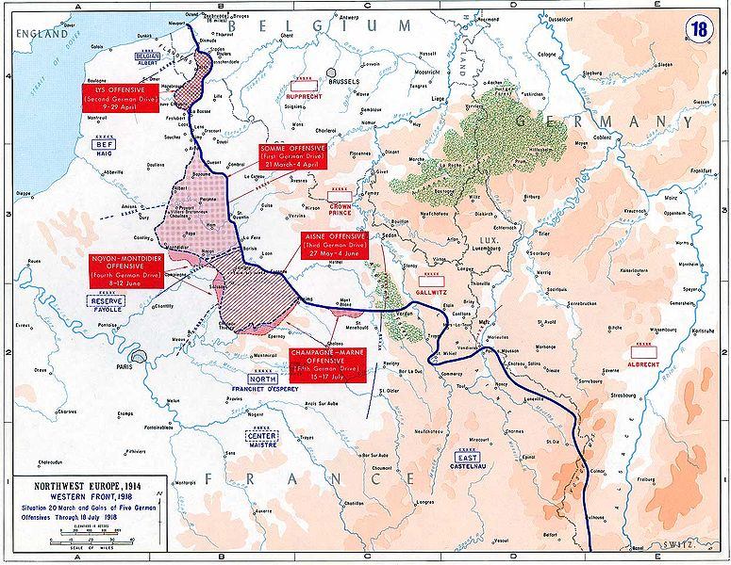

Slide 14
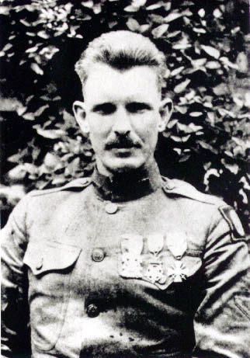
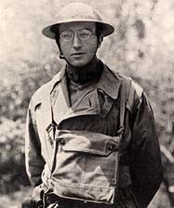
American Heroes
Alvin York – Congressional Medal
of Honor – Captured over 100
Germans basically by himself –
Argonne Forest
Maj. Charles Whittlesey – led the American “Lost Battalion” in the Argonne Forest and resisted continual German attack.
Both men were “Conscientious Objectors” who opposed the war.

Slide 15
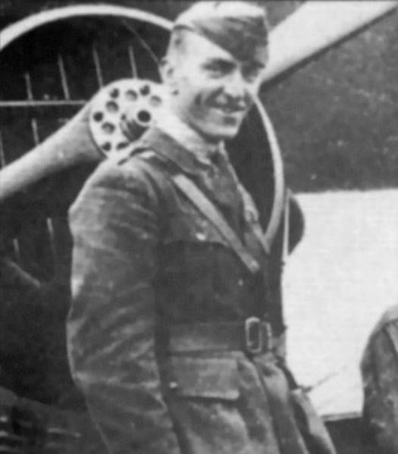
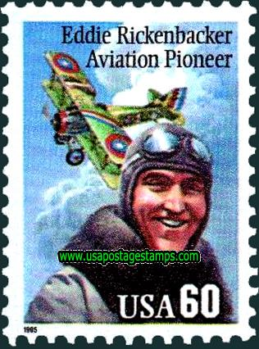
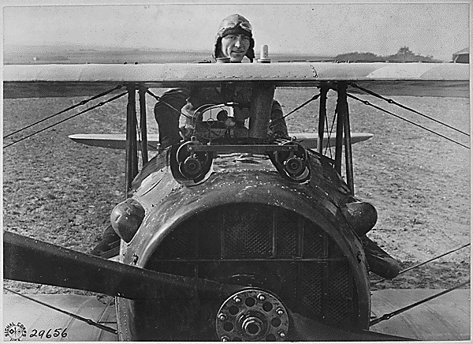
Top American Ace
Eddie Rickenbacker
26 confirmed aerial victories

