Slide 1
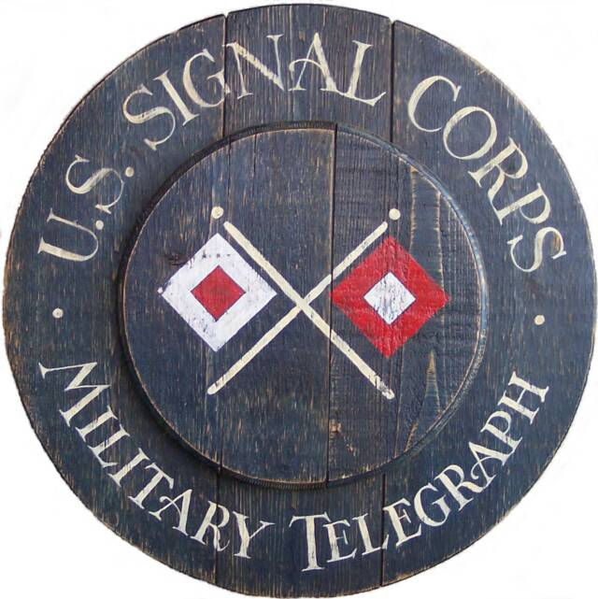
The Signal Corps in the Civil War http://www.civilwarsignal.org

Slide 2
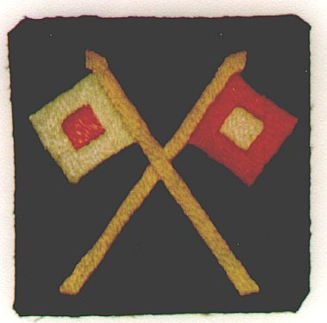
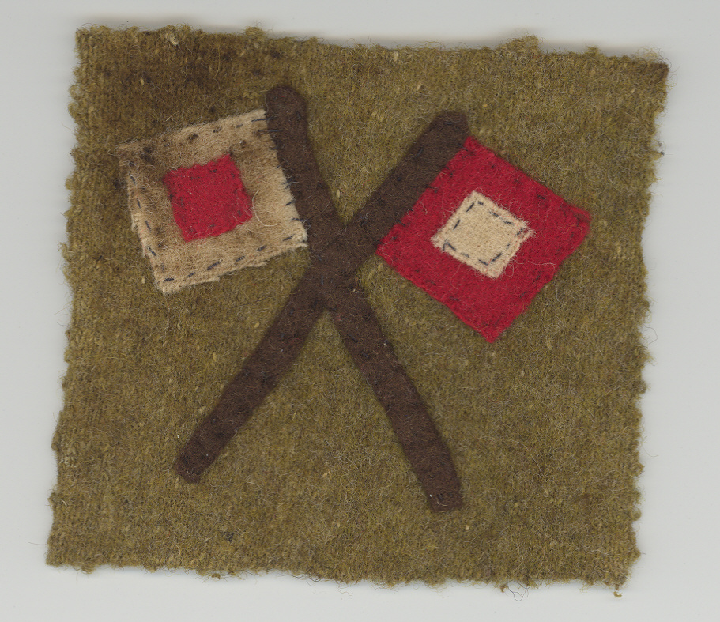
Uniforms
Standards Federal or Confederate Uniforms for Infantry

Slide 3
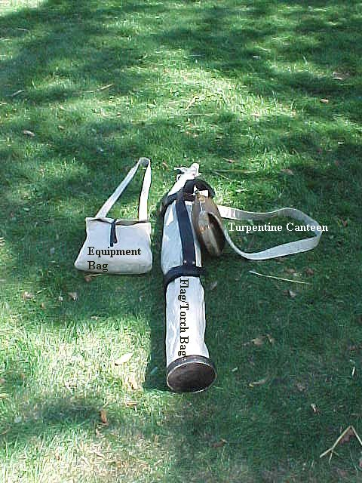
U.S. Signal Corps Kit.

Slide 4
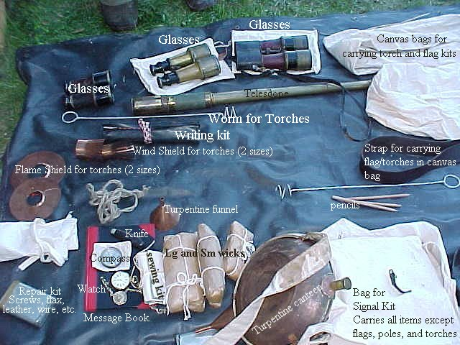

Slide 5
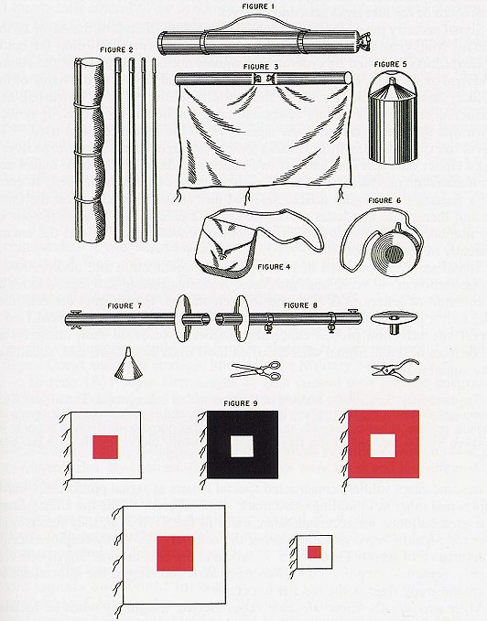
Meyer’s Manual showing what should be in the signaling kit.

Slide 6
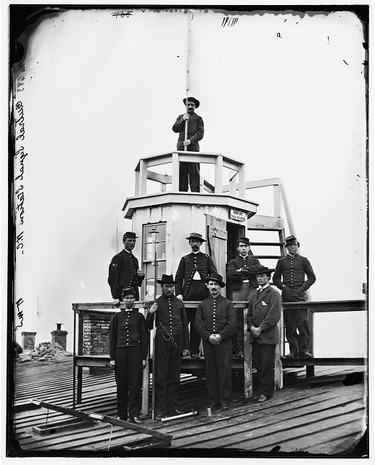
Central Signal Station, Washington D.C.

Slide 7
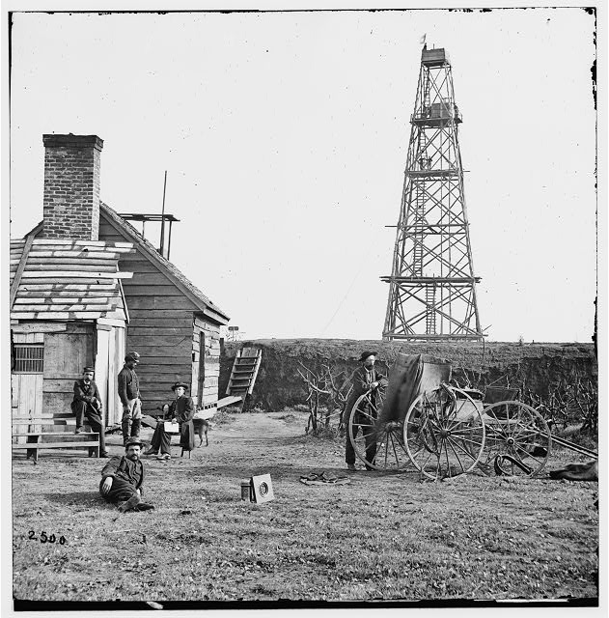
Ben. Butler’s Signal Tower at Bermuda Hundred, Va.

Slide 8
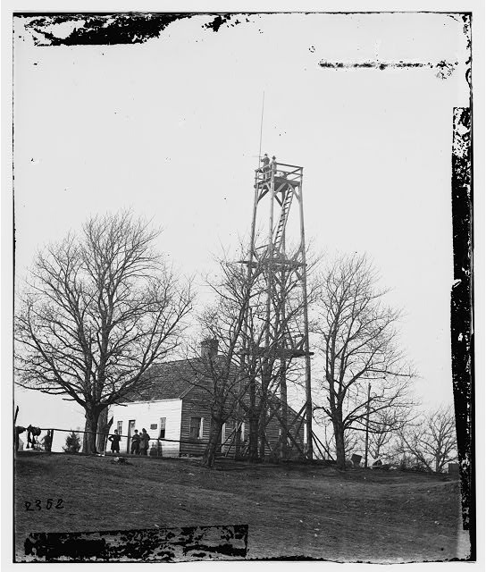
U.S. Signal Tower near Petersburg, VA.

Slide 9
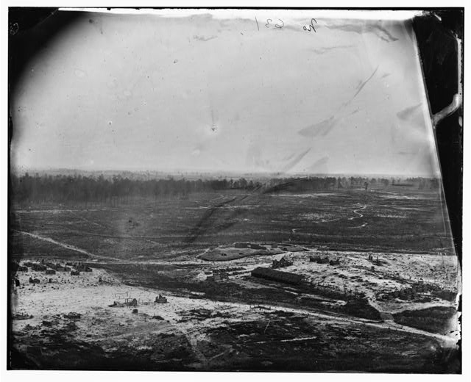
The view from the previous signal tower

Slide 10
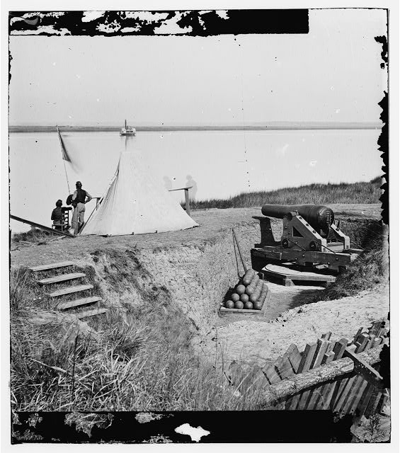
Savannah, Ga., vicinity. Signal station on the Ogeechee at Fort McAllister

Slide 11
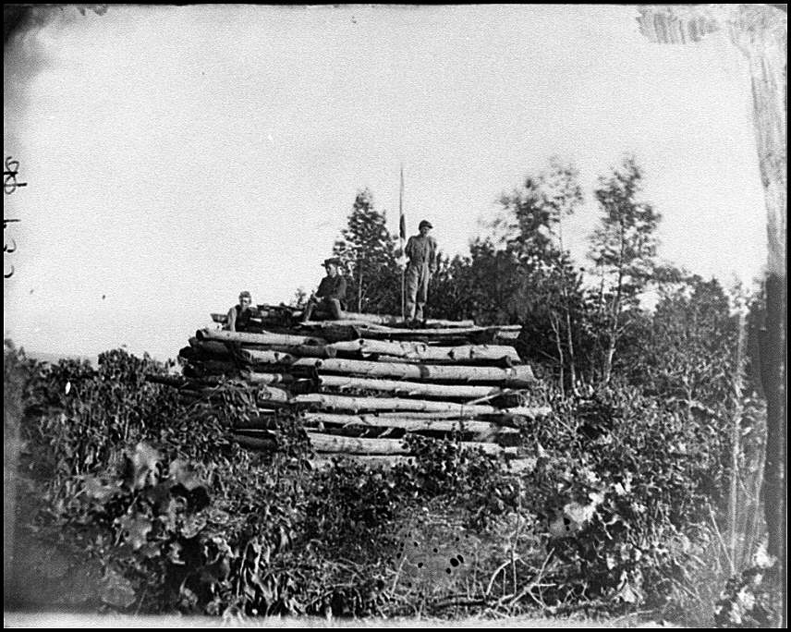

Slide 12
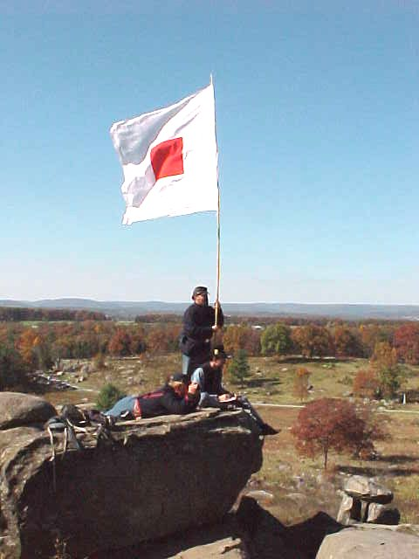
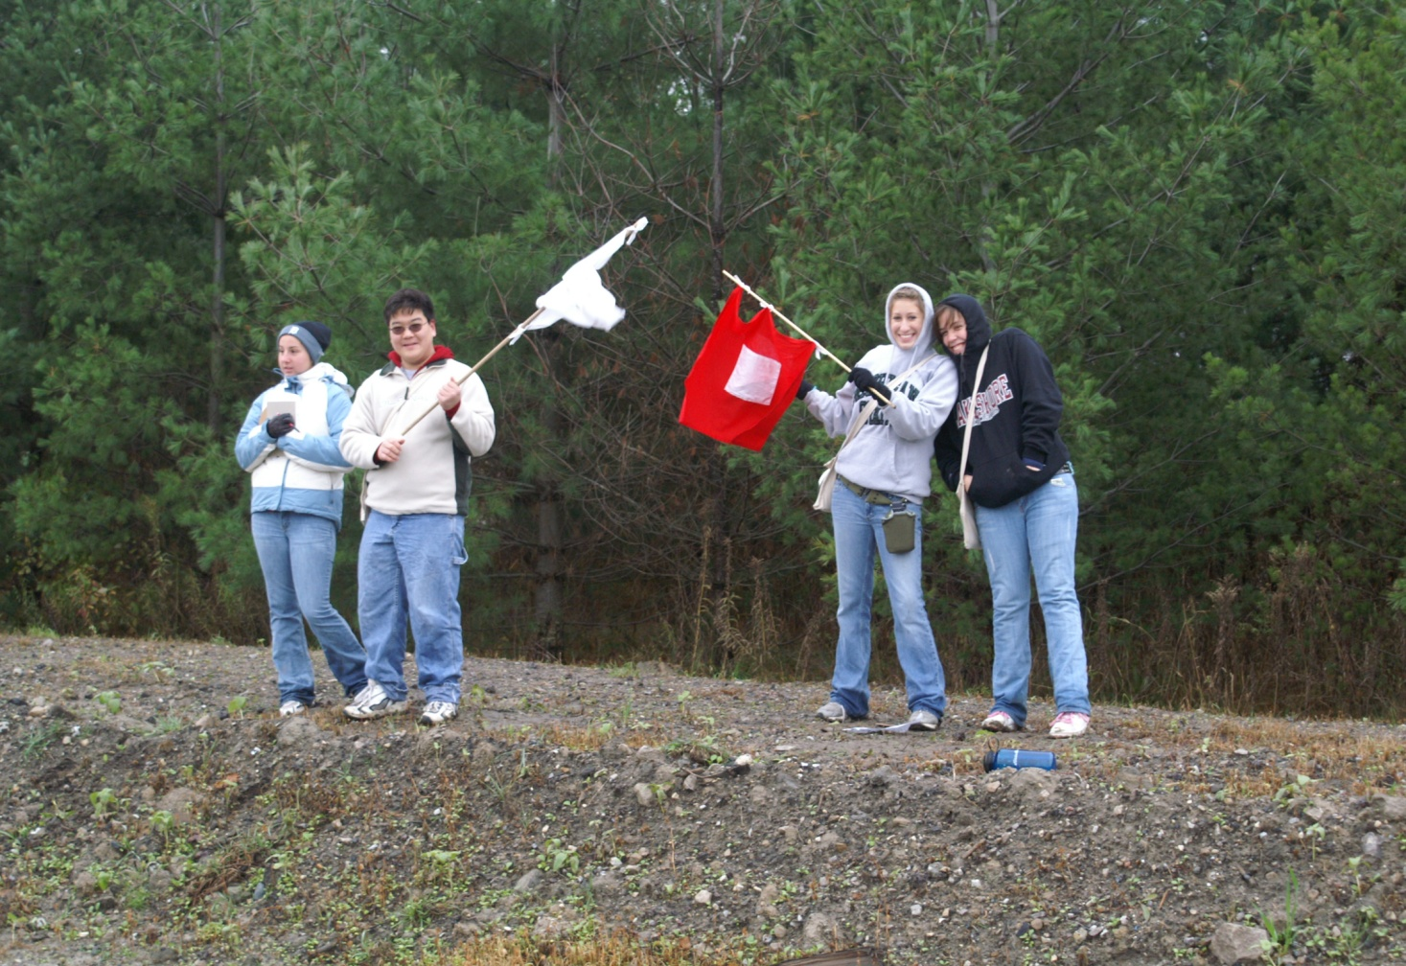
Practice?
http://www.civilwarsignal.org/dotalphabet/animatedalphabet.htm

